Slide 1
Python - Operators
Premanand S

Slide 2
Basic terminologies
Operand
Operator
Output of the operation / solutions

Slide 3
Operators
Arithmetic operators
Comparison operators
Logical operators
Bitwise operators
Assignment operators
Identity operators
Membership operators

Slide 4
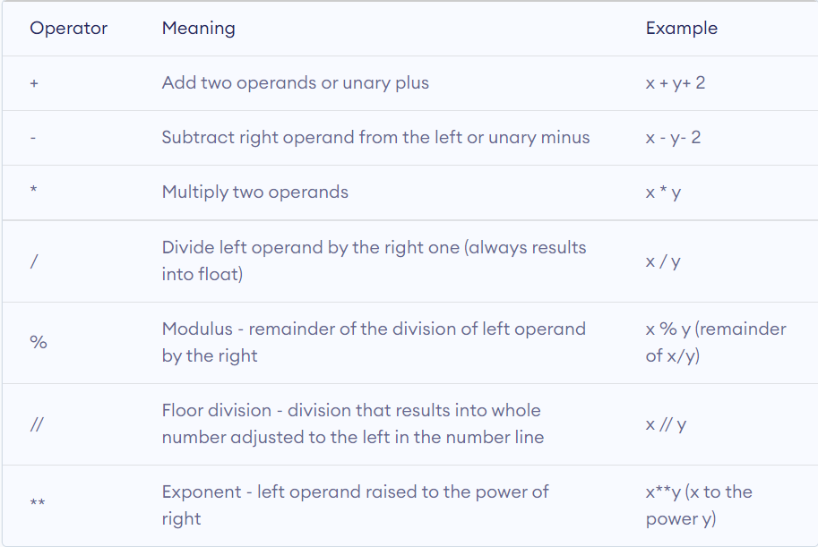
Arithmetic Opertators

Slide 5
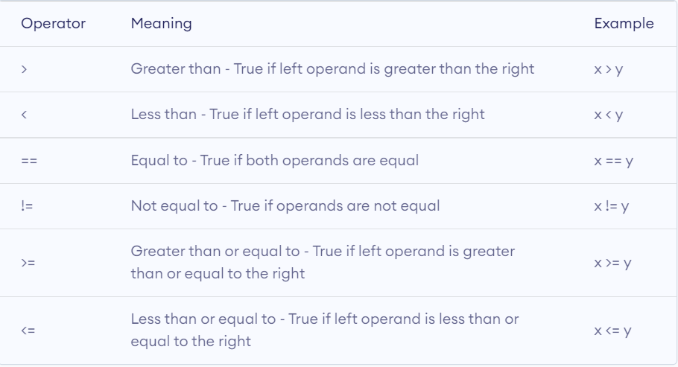
Comparative operators

Slide 6
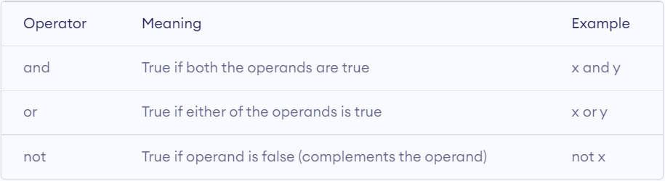
Logical operators

Slide 7
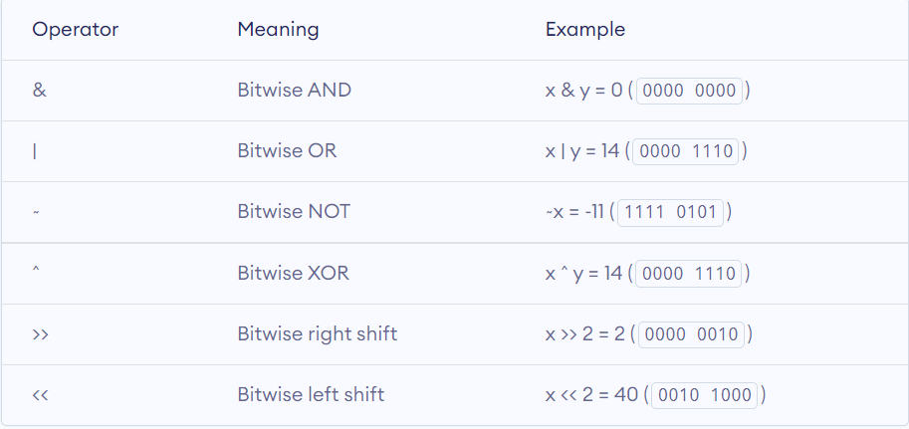
Bitwise operator

Slide 8
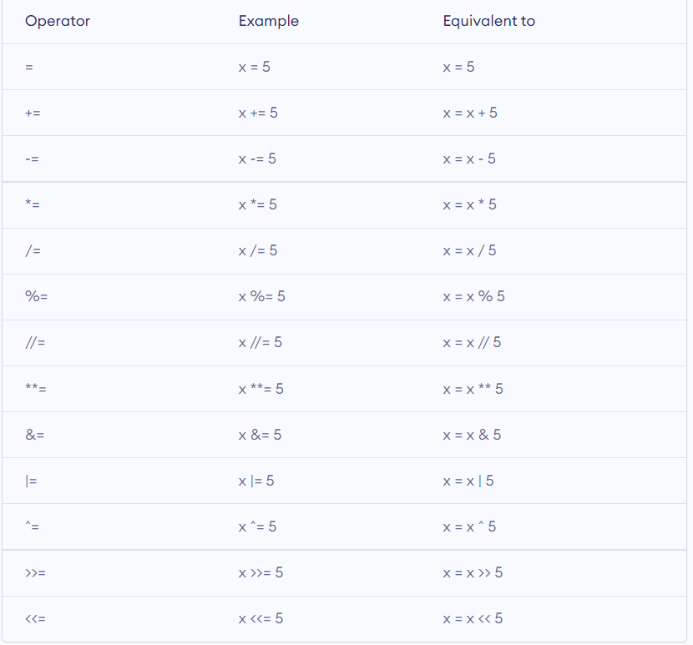
Assignment operator

Slide 9
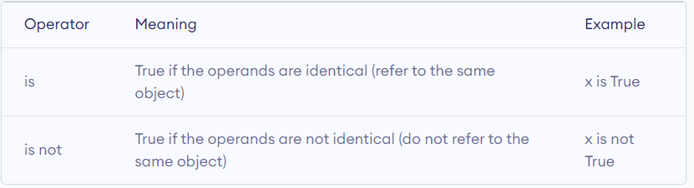
Identity operator

Slide 10
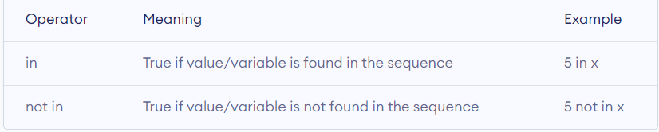
Membership operator

